Slide 1

MALLA REDDY INSTITUTE OF TECHNOLOGY AND SCIENCES
An UGC Autonomous Institution Approved by AICTE New Delhi and Affiliated to JNTU
EAMCET Code: MRIT
JNTUH Code: S1
An ISO 9001: 2015 Certified Institution
Accredited by NBA and NAAC
India Rankings 2023-NIRF Innovation Band 151-300
Maisammaguda, Medchal (Dist) , Hyderabad -500100, Telangana. Email : mrits.s1@gmail.com, www.mrits.ac.in
DEPARTMENT OF CSE (CYBER SECURITY)
Fake Job Post Prediction Using Machine Learning Algorithms
PRESENTED BY: UNDER GUIDANCE OF:
M.ABHINAI (21S11A6201) Mr. M. Bharath Kumar
T.SRIKANTH (21S11A6256) (B.TECH) (M.TECH)
J.SANTOSH GOUD (21S11A6250) ASSISTANT PROFESSOR
R.LAHARI (21S11A6217) DEPARTMENT OF CSE(CS)

Slide 2
Title Explanation
Fake Job Post: Refers to job postings that are fraudulent in nature. These could be postings for non-existent jobs & scam job offers.
Prediction: Indicates that the goal is to forecast or determine in advance whether a job posting is fake or legitimate based on certain criteria or features.
Using Machine Learning Algorithms: Highlights the methodology employed, which involves leveraging various machine learning models and techniques to analyze data related to job postings and classify them as either genuine or fake.

Slide 3
ABSTRACT
During the pandemic, there is strong rise in the number of online job posted on various job portals. So, fake job posting prediction task is going to be big problems for all.
Thus, these fake jobs can be precisely detected and classified from a pool of job posts of both fake and real jobs by using advanced deep learning as well as machine learning classification algorithms.
This paper proposed to use different data mining techniques and classification algorithm like KNN, decision tree, support vector machine, naive bayes classifier, random forest classifier, multilayer perceptron and deep neural network to predict a job post if it is real or fraudulent.
We have experimented on Dataset which containing 18000 employee samples .We have used three dense layers for this deep neural network classifier.

Slide 4
INTRODUCTION
In modern time, the development in the field of industry and technology has opened a huge opportunity for new and diverse jobs for the job seekers.
With the help of the advertisements of these job offers, job seekers find out their options depending on their time, qualification, experience, suitability etc.
Recruitment process is now influenced by the power of internet and social media. Since the successful completion of a recruitment process is dependent on its advertisement, the impact of social media over this is tremendous.

Slide 5
EXISTING SYSTEM
Vidros et al. identified job scammers as fake online job advertiser. They found statistics about many real and renowned companies and enterprises who produced fake job advertisements or vacancy posts with illmotive. They experimented on EMSCAD dataset using several classification algorithms like naive bayes classifier, random forest classifier, Zero R, One R etc. Random Forest Classifier showed the best performance on the dataset with 89.5% classification accuracy. Alghamdi et al. proposed a model to detect fraud exposure in an online recruitment system. They experimented on EMSCAD dataset using machine learning algorithm.

Slide 6
PROPOSED SYSTEM
In our proposed model uses to use different machine learning techniques and classification algorithm like
KNN
decision tree
Support vector machine
naive bayes classifier
random forest classifier
multilayer perceptron
to predict a job post if it is real or fraudulent.

Slide 7
TRAINED DATA AND PRE- PROCESSING
Pre- Processing:-
Prior to training and data evaluation using machine learning, data processing is a normal first step.
Algorithms for machine learning are always as useful as information you fed them.
It is important to format correct data and to include relevant items so that they are consistent enough to produce best outcomes possible.
Stopword removal, tokenization, lower case and punctuation removal are all examples of data refinement.

Slide 8
Trained data: In case of conventional machine learning algorithms like KNN, Random Forest, SVM etc. we have used hold out cross validation. data was used for training and 20% was used for testing and checking the model performance. In KNN model, we have applied K value from 1 to 40 and minimum error is found when k= 13. Prediction: User passes the input parameters like Telecommuting, has_company_logo,has_questions, employment_type, required experience, required_education system will predict the given post is fake or real using deep neural network.

Slide 9
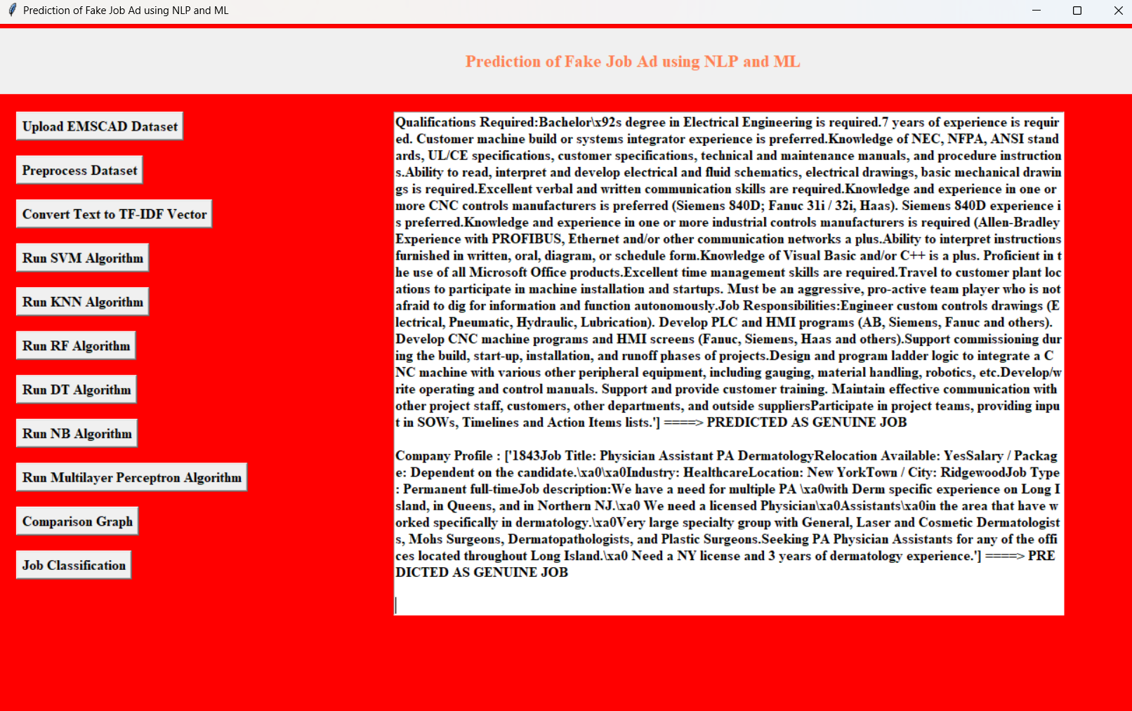
Algorithms:

Slide 10
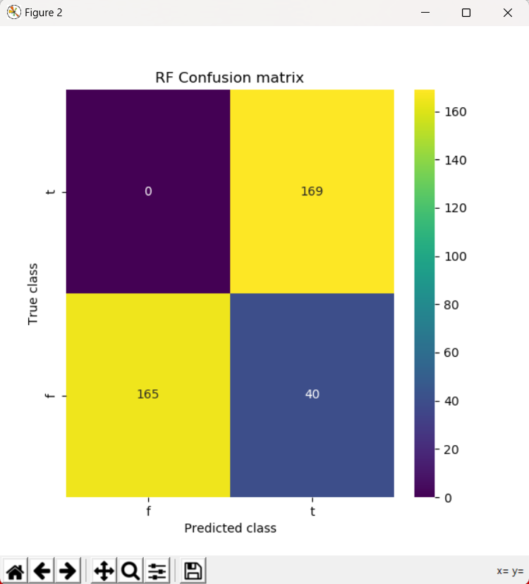
Random Forest
STEP 1: START
STEP 2: SPLIT dataset into 67 percent training set, 33 percent testing set .
STEP 3: FOR train dataset CALL RFClassifier TRAINRFClssifier
STEP 4: FOR test dataset CALL RFClassifier PREDICT the label COMPUTE AccuracyScore SAVE AccuracyScore DISPLAY Confusion Matrix
STEP 5: STOP

Slide 11
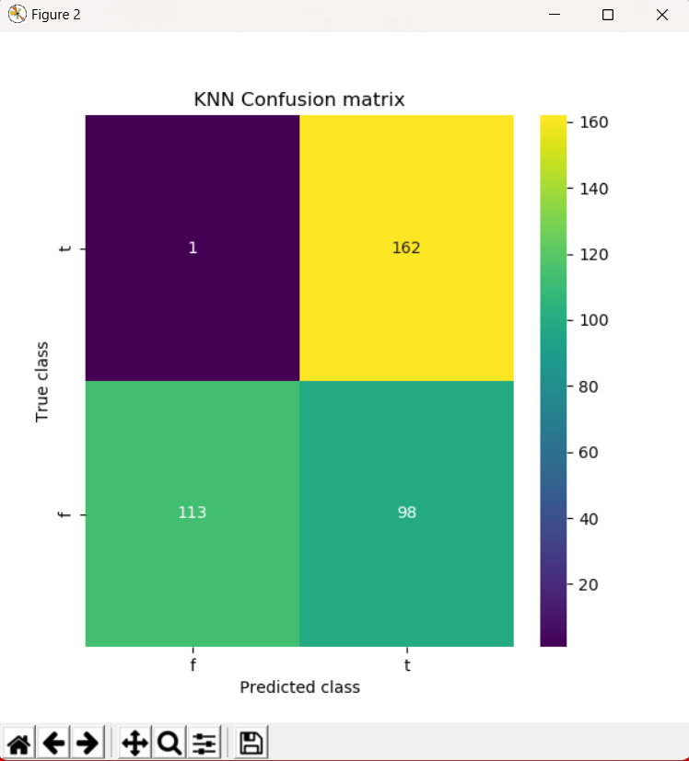
KNN Classifier
Pseudo code Procedure Train()
Input: train set, test set Output: Trained model
Step 1: Read Train set and test set
Step 2: Build KNN classifier
Step 3: Train the model using fit()
Step 4: Performance Graph Returned Trained Model

Slide 12
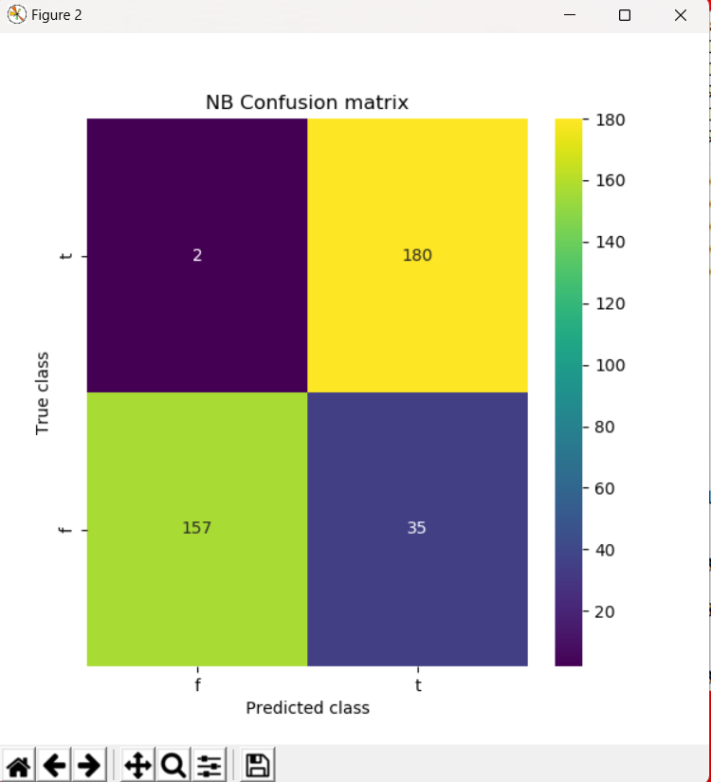
Naïve Bayes
This algorithm is a supervised learning algorithm, which is based on Bayes theorem and used for solving classification problems.
• It is mainly used in text classification that includes a high-dimensional training dataset.
• Naïve Bayes Classifier is one of the simple and most effective Classification algorithms which helps in building the fast machine learning models that can make quick predictions.
STEP 1: START
STEP 2: SPLIT dataset into 67 percent training set, 33 percent testing set
STEP 3: FOR train dataset CALL MultinomialNB TRAIN MultinomialNB
STEP 4: FOR test dataset CALL MultinomialNB PREDICT the label COMPUTE AccuracyScore SAVE AccuracyScore DISPLAY ConfusionMatrix STEP 5: STOP

Slide 13
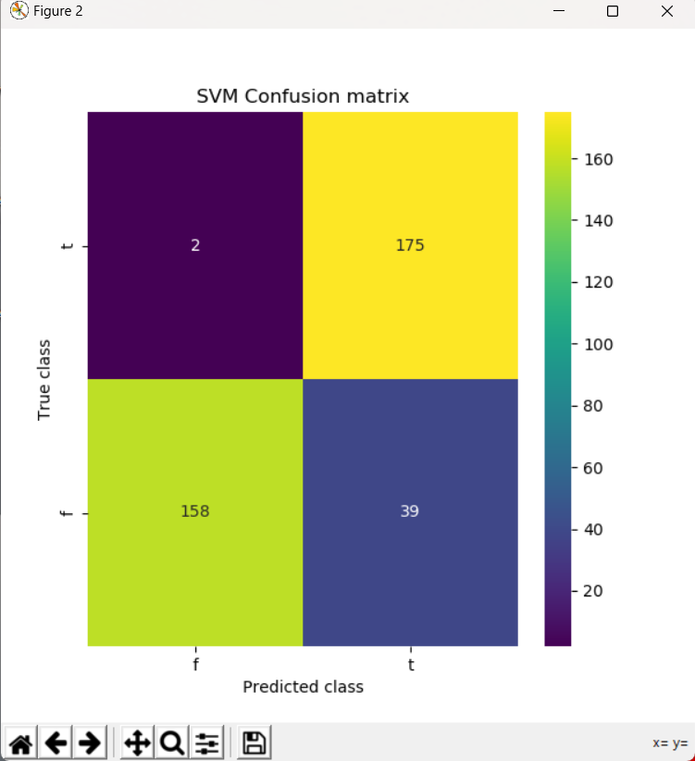
Support Vector Machine (SVM)
It shows many unique advantages in a small sample, nonlinear, and high-dimensional pattern recognition and can be extended to other functions such as function fitting ML problems. Before the rise of deep learning, SVM was considered the most successful and best-performing machine learning method in recent decades. The SVM method is based on the Vapnik Chervonenkis(VC) dimension theory of statistical learning theory and the principle of structural risk minimization.
STEP 1: START
STEP 2: SPLIT dataset into 67 percent training set, 33 percent testing set.
STEP 3: FOR train dataset CALL SVMClassifier TRAIN SVMClassifier
STEP 4: FOR test dataset CALL SVMClassifier PREDICT the label COMPUTEAccuracyScore DISPLAY ConfusionMatrix
STEP 5: STOP

Slide 14
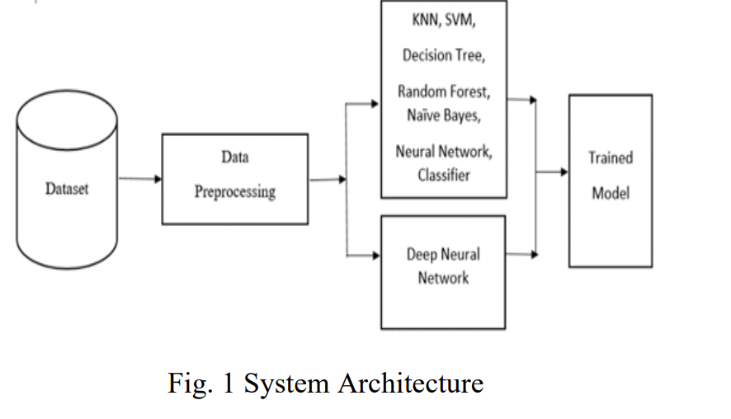
System Architecture
The system “design” is defined as the process of applying various requirements and permits it physical realization.
Various designs are followed to develop the system the design specification describes the features of the system, the opponent or elements of the system and their appearance to the end-users. The below figure.
illustrates the steps in fake job post detection system, Data preprocessing first performed in our fake job post detection structure, including duplicate, outlier, and missing value processing.
Then, we are applying various machine learning and deep learning algorithms to train the model to detect the fake job post detection.

Slide 15
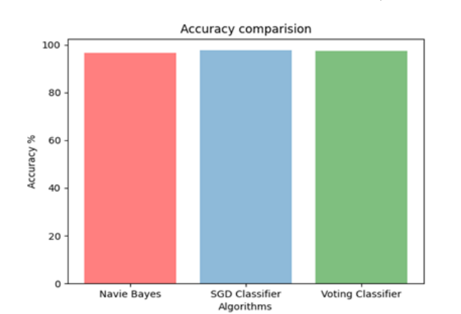
.
RESULTS AND DISCUSSION
The system was created using Windows 11 as well as a 64-bit processor with 8 GB of RAM. The model implemented with the help of Python v3.7.8
Accuracy comparison between algorithms From the values calculated in the confusion matrix, an accuracy graph is generated for each algorithm for comparison for best algorithm with highest accuracy.

Slide 16
CONCLUSION
In this work, we have developed a fake job post detection software by applying supervised machine learning algorithms to classify a given job post taken as input from user, as real or fake.
A simple approach for fake job post detection using is performed using KNN classifier. The way they get these probabilities is by using KNN, which describes the probability of a feature which has misclassification and less prediction.
In this proposed model, initially for training 80% data is being used, and for testing 20% of data are pre-processed.

Slide 17
REFERENCES:
S. Vidros, C. Kolias , G. Kambourakis ,and L. Akoglu, “Automatic Detection of Online Recruitment Frauds: Characteristics, Methods, and a Public Dataset”, Future Internet 2017, 9, 6; doi:10.3390/fi9010006.
Alharby, “An Intelligent Model for Online Recruitment Fraud Detection”, Journal of Information Security, 2019, Vol 10, pp. 155- 176,https://doi.org/10.4236/iis.2019.103009.
Tin Van Huynh1, Kiet Van Nguyen, Ngan LuuThuy Nguyen1, and Anh Gia-Tuan Nguyen, “Job Prediction: From DNN Models to Applications”, RIVF International Conference on Computing and Communication Technologies (RIVF), 2020.
Jiawei Zhang, Bowen Dong, Philip S. Yu, “FAKEDETECTOR: Effective Fake News Detection with Deep Diffusive Neural Network”, IEEE 36th International Conference on Data Engineering (ICDE), 2020.

Slide 18
THANK YOU

